Slide 1
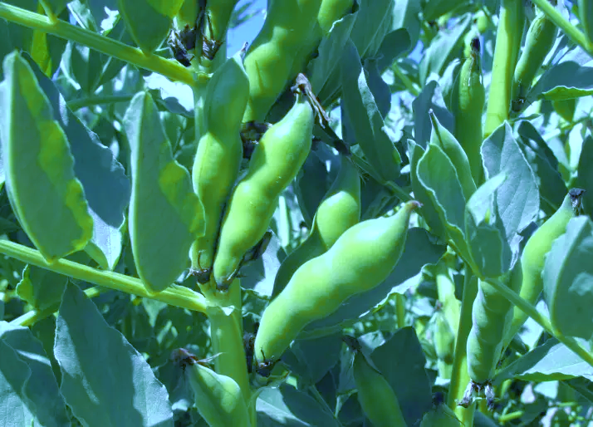


First metabolomic results
03/07/2025
Identification of the determinants of resistance in faba bean to two aphid species.
Author: Paul Fremaux
Supervisor: Akiko Sugio
Co-Supervisor: Marc Galland

Slide 2
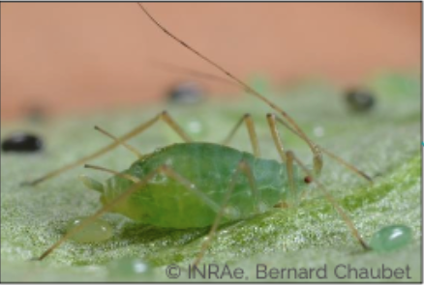
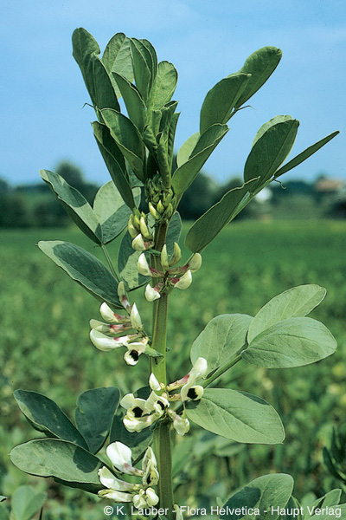
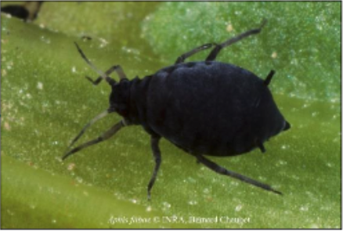
Context – State of the art – Strategy – First results – Future perspectives
Presentation of the plant/aphid model
Pea aphid (Acyrthosiphon pisum)
-Specialized on legumes
Transmit over 30 viruses
-Several biotype adapted to different plants
-All biotypemay develop on faba bean
Faba bean is a crop with many advantages
Independence of plant based protein production in Europe
Agronomic benefits linked to nitrogen fixation
Integration into crop rotations to break disease cycles
Pollen source for pollinizer when only few plants are flowering
Black aphid (Aphis fabae)
-Generalist with a preference for legumes
-Transmit the beet yelow virus
-More common on faba bean than the pea aphid
Up to 50 % yield loss due to direct and indirect damages
p.4

Slide 3
Objectives of the project :
Which genes are linked with resistance ?
GWAS analysis of 240 plant genotypes:
Phenotype + Genotyping data → area in the genome linked with resistance
Is there a genetic response of the plants in contact with aphids ?
Transcriptomic analysis of 2 contrasted plant genotypes under 2 conditions with or without
Which metabolites are associated with faba bean resistance to aphids ?
Metabolomic analysis of 2 plant genotypes under 2 conditions

Slide 4
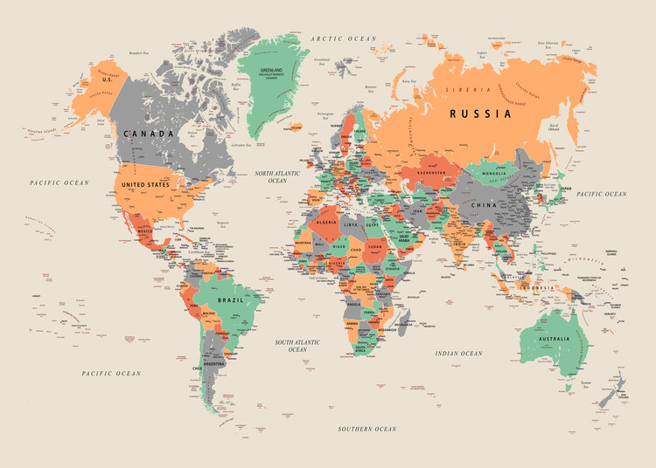
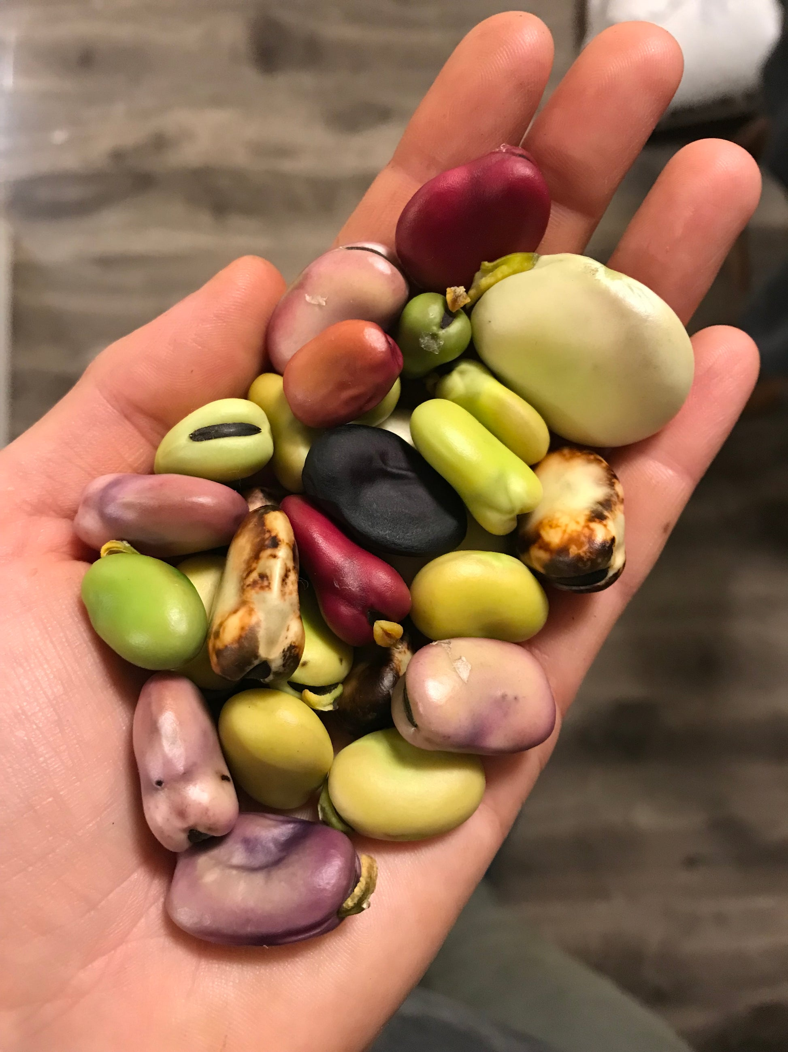
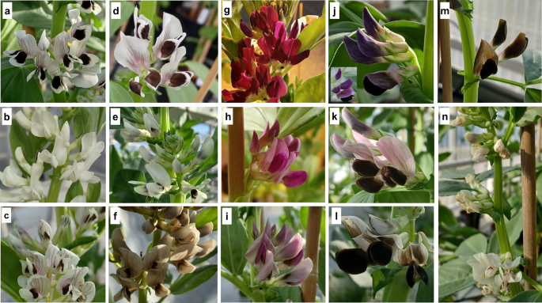
Presentation of the population :
The population consist of 220 Faba bean genotypes from various region of the world
Continent | Count | Percentage
Africa | 19 | 8.64%
Asia | 60 | 27.27%
Europe | 113 | 51.36%
North America | 3 | 1.36%
South America | 25 | 11.36%
Category | Count | Percentage
Traditional Landrace | 116 | 52.46%
Advanced/Improved Cultivar | 46 | 20.85%
Other (Breeding/Research Material, Mutant, etc.) | 52 | 23.54%

Slide 5
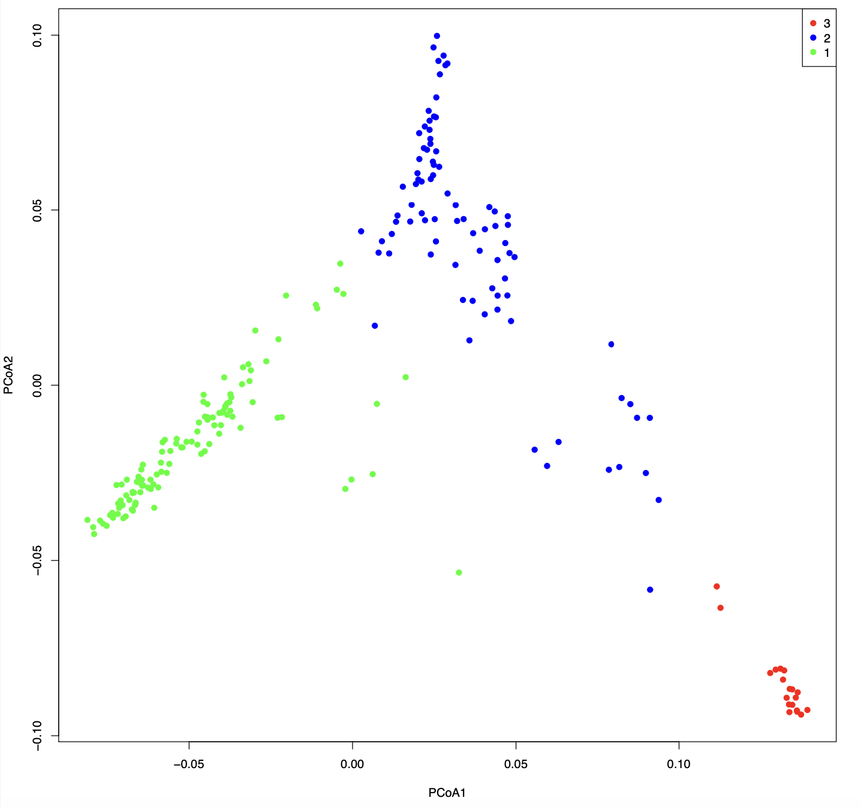
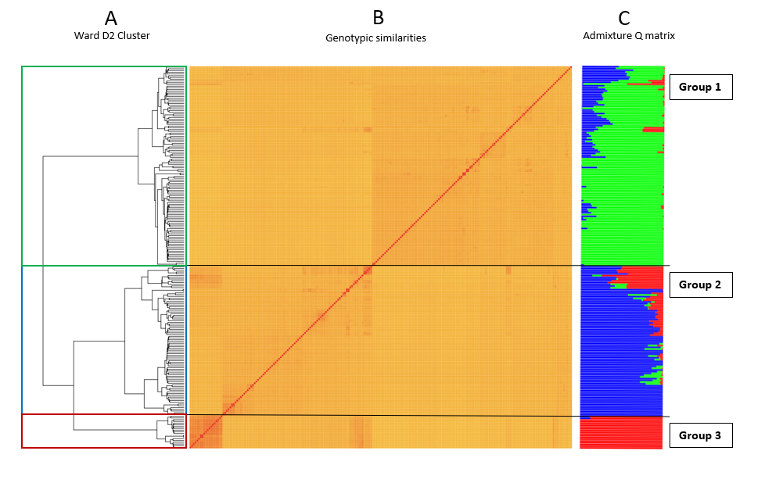
Clustering of the genetic groups
South
North
East
Population clustering based on matrix genomic similarities with admixture proportion
confirmation with a PCoA analysis

Slide 6
Clustering of the genetic groups
south america
South
south European
North
Middle East
East
Population clustering based on matrix genomic similarities with admixture proportion
confirmation with a PCoA analysis

Slide 7
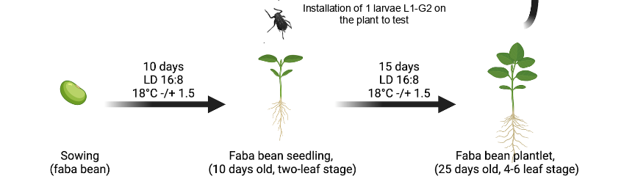
Phenotyping method
Aphid fecundity is used as a proxy of resistance
the number of offspring on each plant is counted

Slide 8
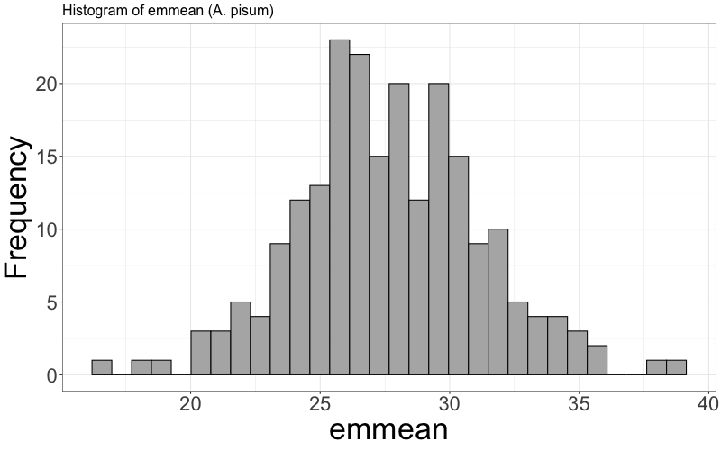
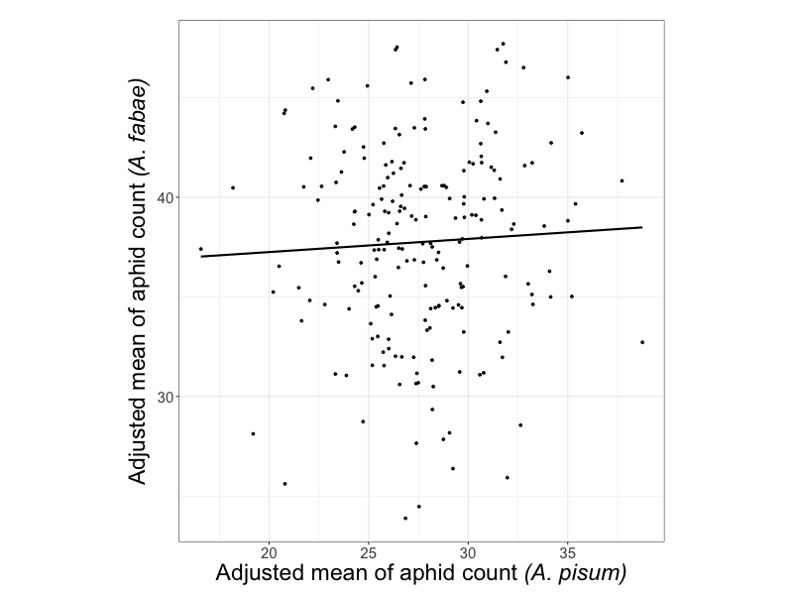
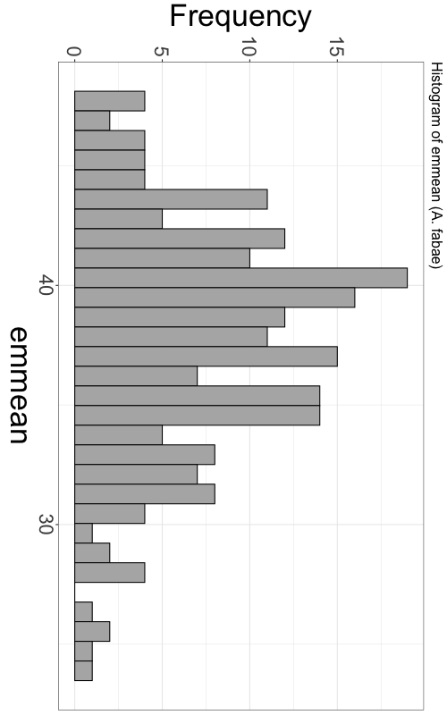
Result of the phenotypic screening
Distribution of the resistance level among the genotypes is normal
There is no correlation between the resistance level of faba beans against A. pisum and A. fabae
Resistance is likely coded by few minor resistance genes specific to the aphid species

Slide 9
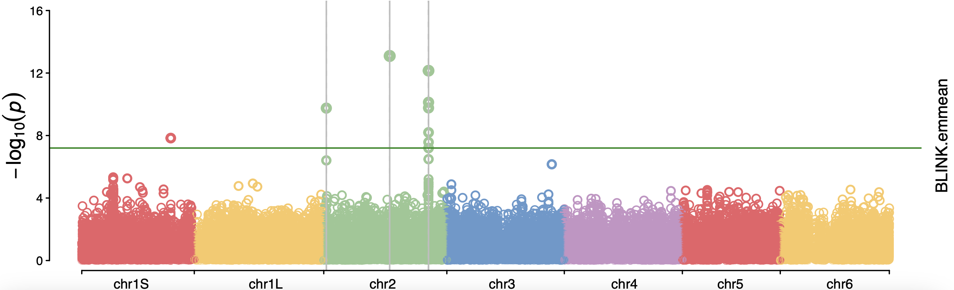
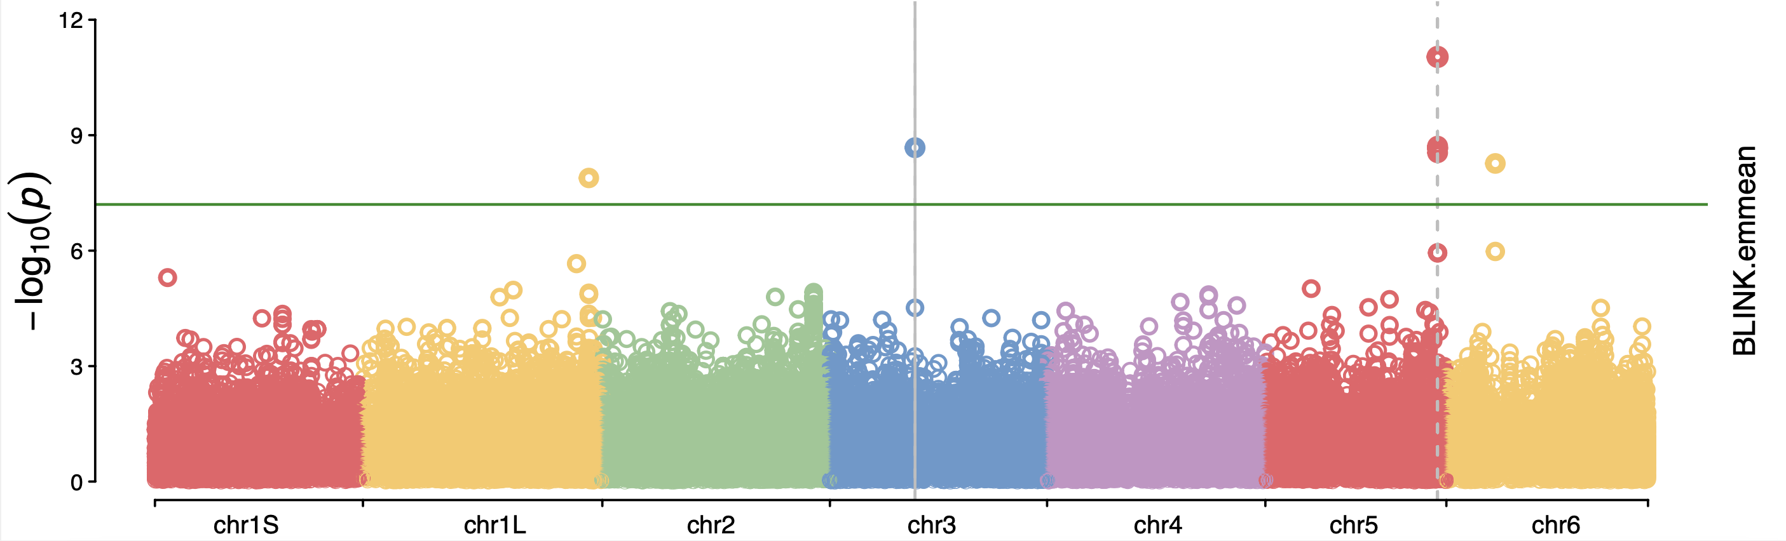
Result of the GWAS analysis
APRII.2
APRII.3
The region associated with resistance against both aphids are different
APRII.1
APRIS
218 geno.
792,490 SNPs
BLINK method
208 geno.
793,086 SNPs
BLINK method

Slide 10
QTL | CHROM | Variant type | Function | Note
APRIS | 1S | upstream_gene_variant | transcription factor | ABA responsive transcription factor
APRII.1 | 2 | intron_variant | E3 ubiquitin-protein ligase KEG | negative regulator of ABA signaling in trans-Golgi network / early endosome vesicles
APRII.2 | 2 | intron_variant | DNA topoisomerase 3-alpha
APRII.3 | 2 | upstream_gene_variant | E3 ubiquitin-protein ligase | potentially involved in stress response and ABA response
 | 2 | upstream_gene_variant | uncharacterised
Hypothesis 1:
Hypothesis 2:
Manipulation of the ABA signaling pathway
APRII.1
APRII.1
Transcription factors and E3 ubiquitin ligase
SA plant response
ABA plant response
APRII.3
APRIS
APRII.3
APRIS

Slide 11
QTL | CHROM | Variant type | Function | Note
AFRIL | 1L | missense_variant | Trypsin-like serine endopeptidase | Trypsin-like serine endopeptidase controled by Ca2+ involved in the processing of glyoxysomal precursor
AFRIII | 3 | intron_variant | ACT domain-containing protein ACR | Transcription factor that may be involved in the regulation of ROS and SA
 |  | upstream_gene_variant | Mitochondrial substrate carrier family protein
AFRV | 5 | intron_variant | 2A protein phosphatase | A protein phosphatase controlled by CA2+. Regulate a key regulatory step of the mevalonate pathway for isoprenoid biosynthesis.
AFRVI | 6 | synonymous_variant | Uncharacterised
Ca2+ plant response

Slide 12
Few interesting candidate genes
E3 ubiquitin ligases potentially involved in stress response
ABA mediated response could be involved in resistance against A. pisum
ABA mediated response could be involved in resistance against A. pisum
Table 7
Different from remis
No nbs lrr
Diferent between pisum and fabae
Trypsin-like serine endopeptidase controled by Ca2+ involved in the processing of glyoxysomal precursor.
A protein phosphatase controlled by CA2+. Regulate a key regulatory step of the mevalonate pathway for isoprenoid biosynthesis.
Transcription factor that may be involved in the regulation of ROS and SA
Ca2+ and SA mediated response could be involved in resistance against A. fabae

Slide 13
Choice of the most contrasted genotypes for metabolomic and transcriptomic
phenotypes of 248 genotypes used for GWAS
confirmation of the 20 most contrasted
choice based on aphid fecundity
confirmation of the 10 most contrasted
choice of the 2 most contrasted couple
choice based on aphid fecundity, genetic group and QTL
2

Slide 14
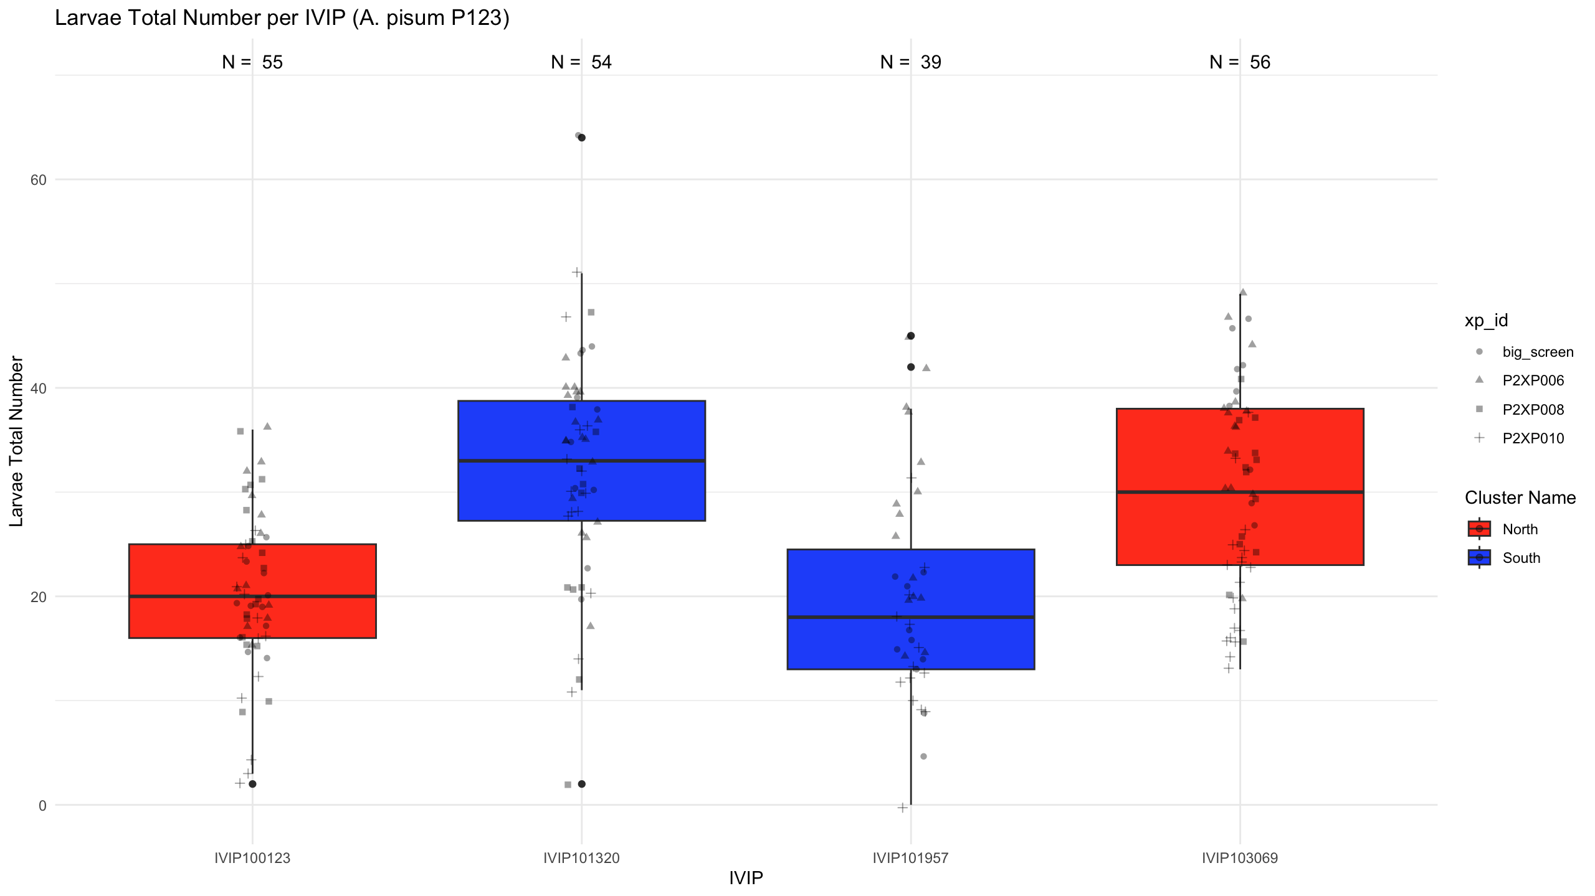
06/2025
Last step of the genotype selection (A. pisum)
06/2025
Prerovsky
IG 11734
CANAKKALE
ANATOLIEN
4
Notes:
Prevosky is still resistant, and we have a susceptible northern genotype. However, the difference between the two southern genotypes is greater than that between the two northern genotypes.
Conclusion:
For both A.pisum and A. fabae we have a pair of genotypes from the South cluster.
What abut prevosky? Can we keep it without a suceptible genotype to A.fabae?
This genotype is quitte inportant as it is resistant to both Aphid species.
To be continued...

Slide 15
06/2025
Last step of the genotype selection (A. pisum)
chr1S_1240520268
chr2_920208494
chr2_1461736473
chr2_35683372
chr1S_1240520268
chr2_920208494
chr2_1461736473
chr2_35683372
chr1S_1240520268
chr2_920208494
chr2_1461736473
chr2_35683372
chr1S_1240520268
chr2_920208494
chr2_1461736473
chr2_35683372
06/2025
Prerovsky
IG 11734
CANAKKALE
ANATOLIEN
4
Notes:
Prevosky is still resistant, and we have a susceptible northern genotype. However, the difference between the two southern genotypes is greater than that between the two northern genotypes.
Conclusion:
For both A.pisum and A. fabae we have a pair of genotypes from the South cluster.
What abut prevosky? Can we keep it without a suceptible genotype to A.fabae?
This genotype is quitte inportant as it is resistant to both Aphid species.
To be continued...

Slide 16
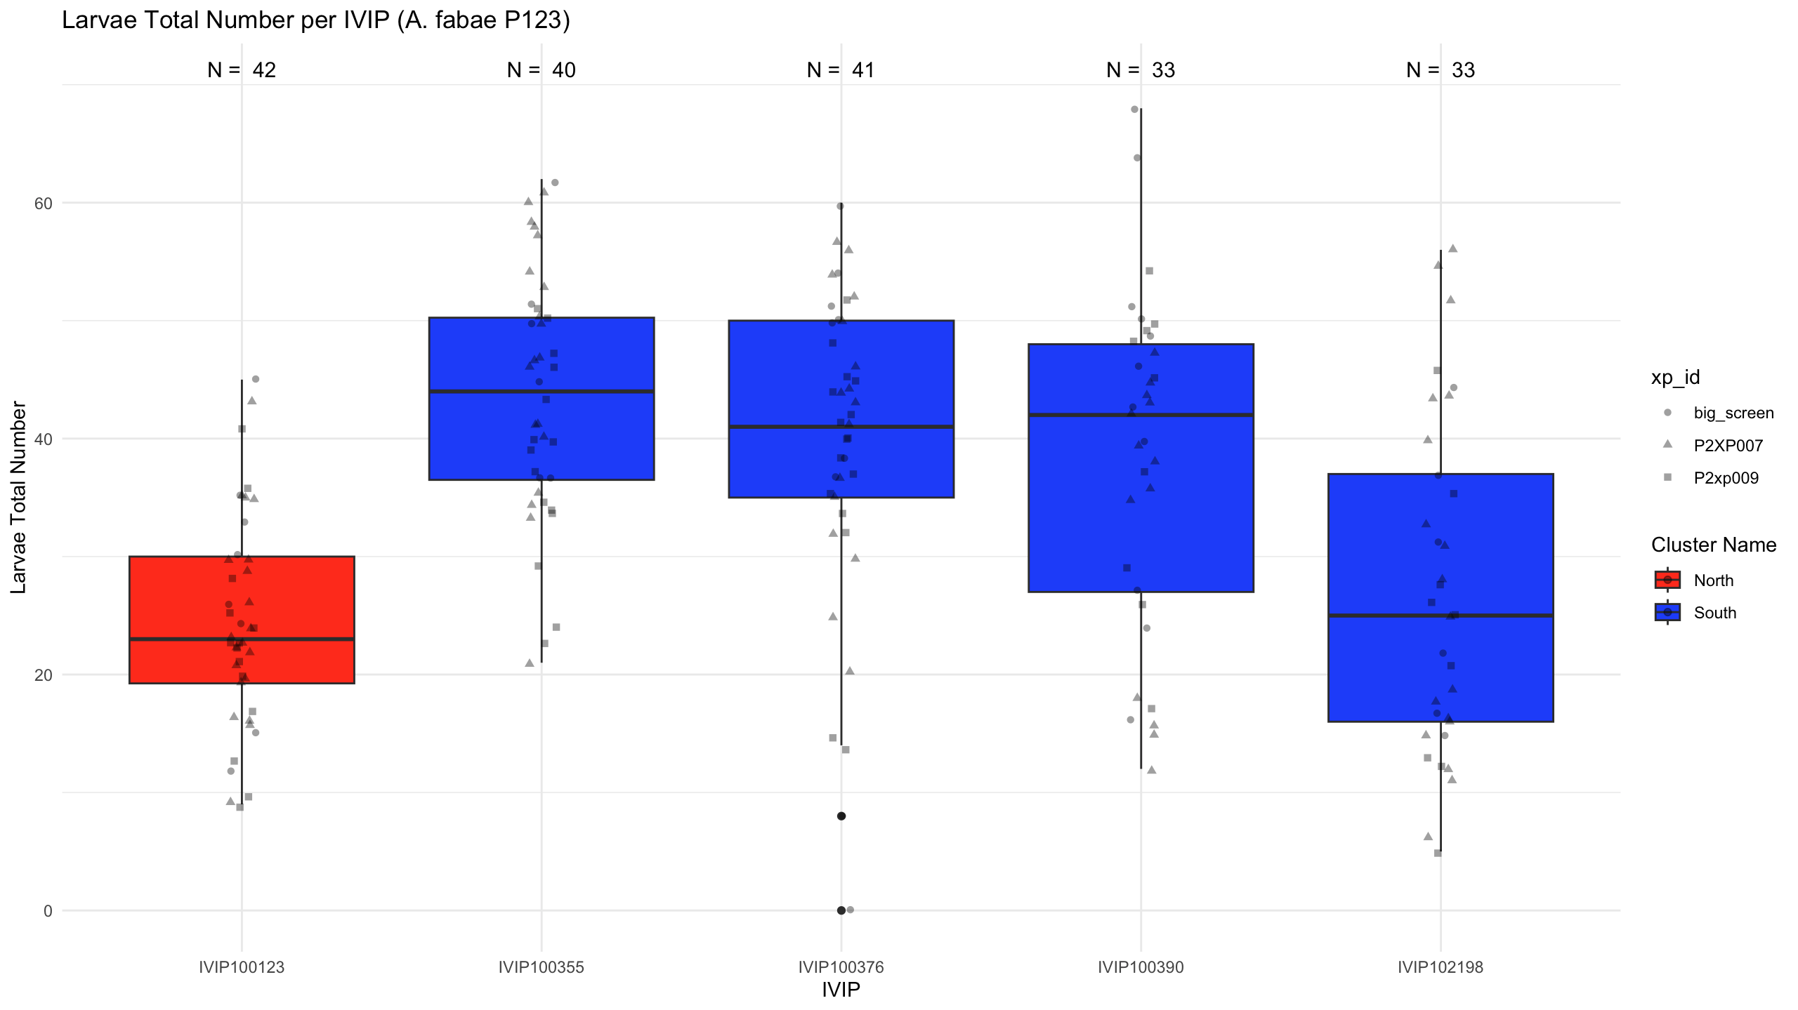
06/2025
Last step of the genotype selection (A. fabae)
)
06/2025
Prerovsky
M10868
KHASH
MAYA CHINE
CS20DK
3
Notes:
Prevosky is the most resistant but there is no susceptible north genotype

Slide 17
06/2025
Last step of the genotype selection (A. fabae)
)
06/2025
Chr6_369308865
Chr5_1299427225
Chr3_641834492
chr1L_1703281021
Chr6_369308865
Chr5_1299427225
Chr3_641834492
chr1L_1703281021
Chr6_369308865
Chr5_1299427225
Chr3_641834492
chr1L_1703281021
Chr6_369308865
Chr5_1299427225
Chr3_641834492
chr1L_1703281021
Chr6_369308865
Chr5_1299427225
Chr3_641834492
chr1L_1703281021
Prerovsky
M10868
KHASH
MAYA CHINE
CS20DK
3
Notes:
Prevosky is the most resistant but there is no susceptible north genotype

Slide 18
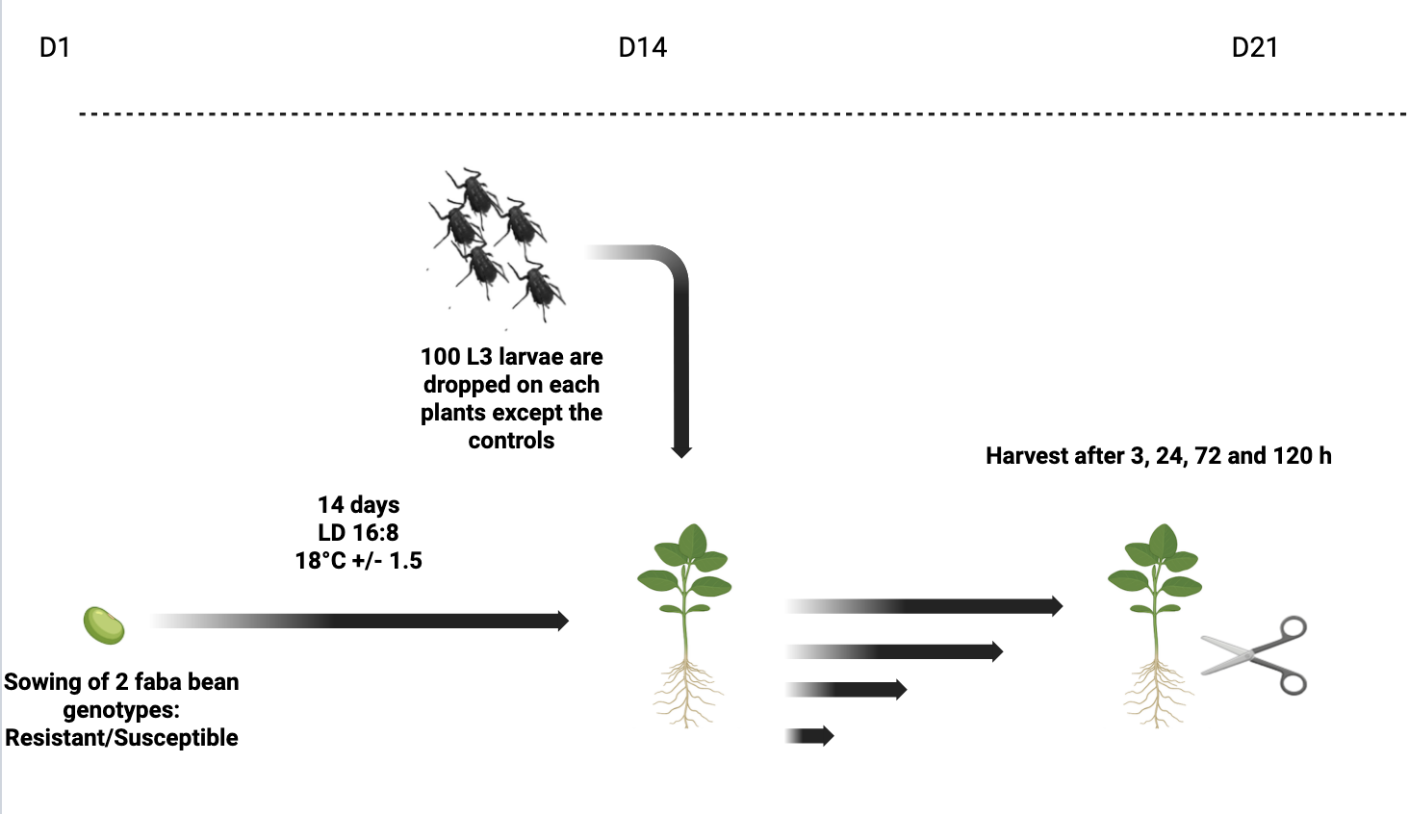
Experimental design: for transcriptomic and metabolomic experiments
Notes:
Ces génotypes ont été semés puis inoculés à 15 jours avec 100 individus L3 > ensuite récoltés à des temps précoces de 3h à 120hpi

Slide 19
Method explanation

Slide 20
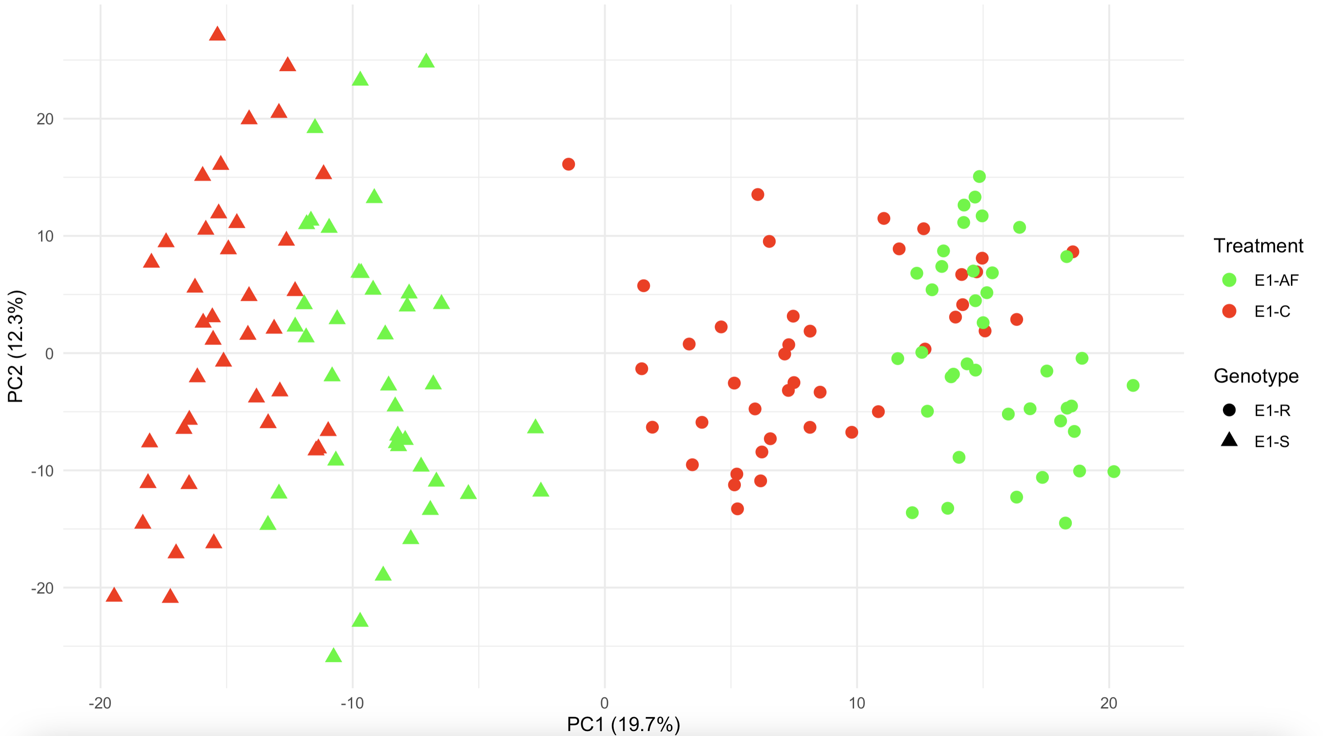
Two first axes of the PCA for the A. fabae experiment with a separation based on genotype and treatment

Slide 21
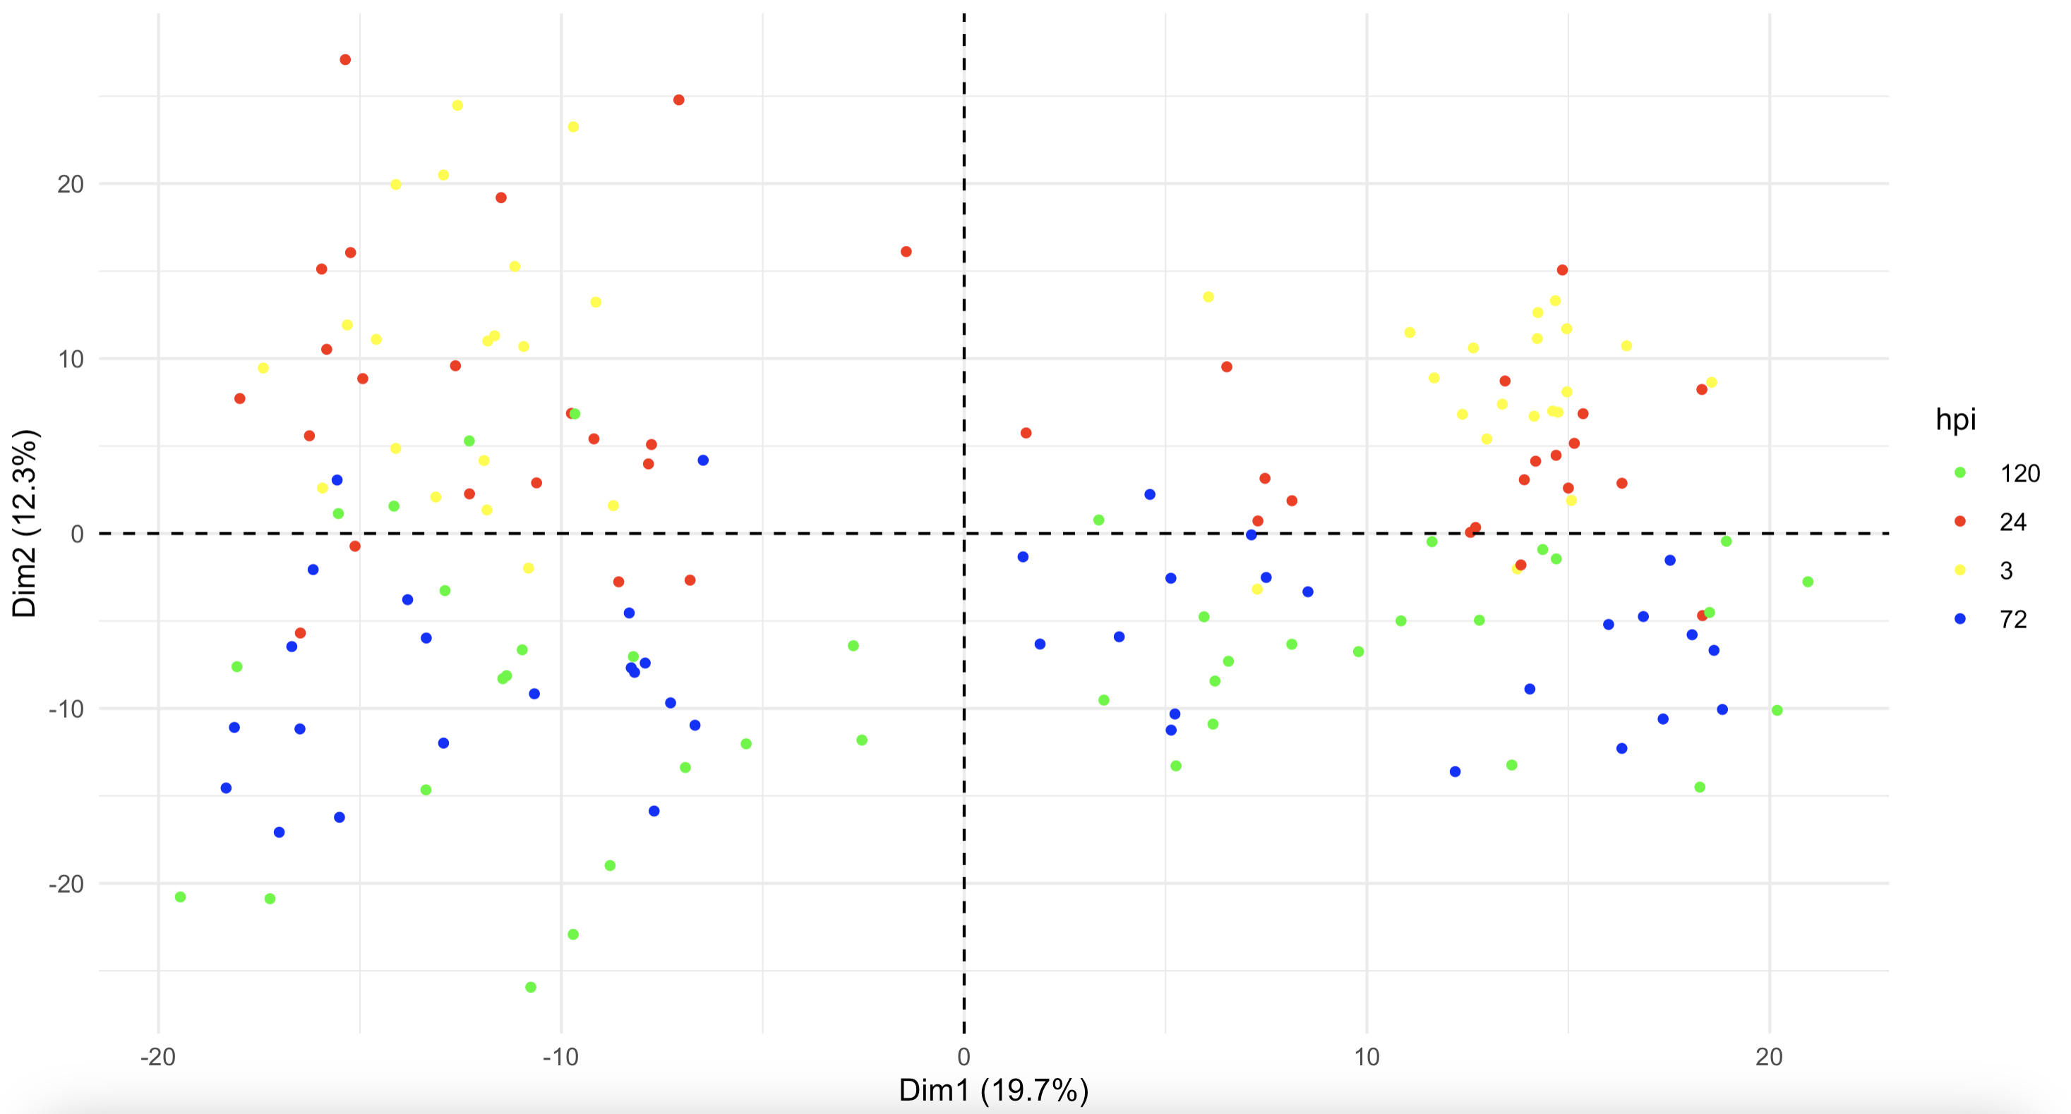
Two first axes of the PCA for the A.fabae experiment with a separation based on time

Slide 22
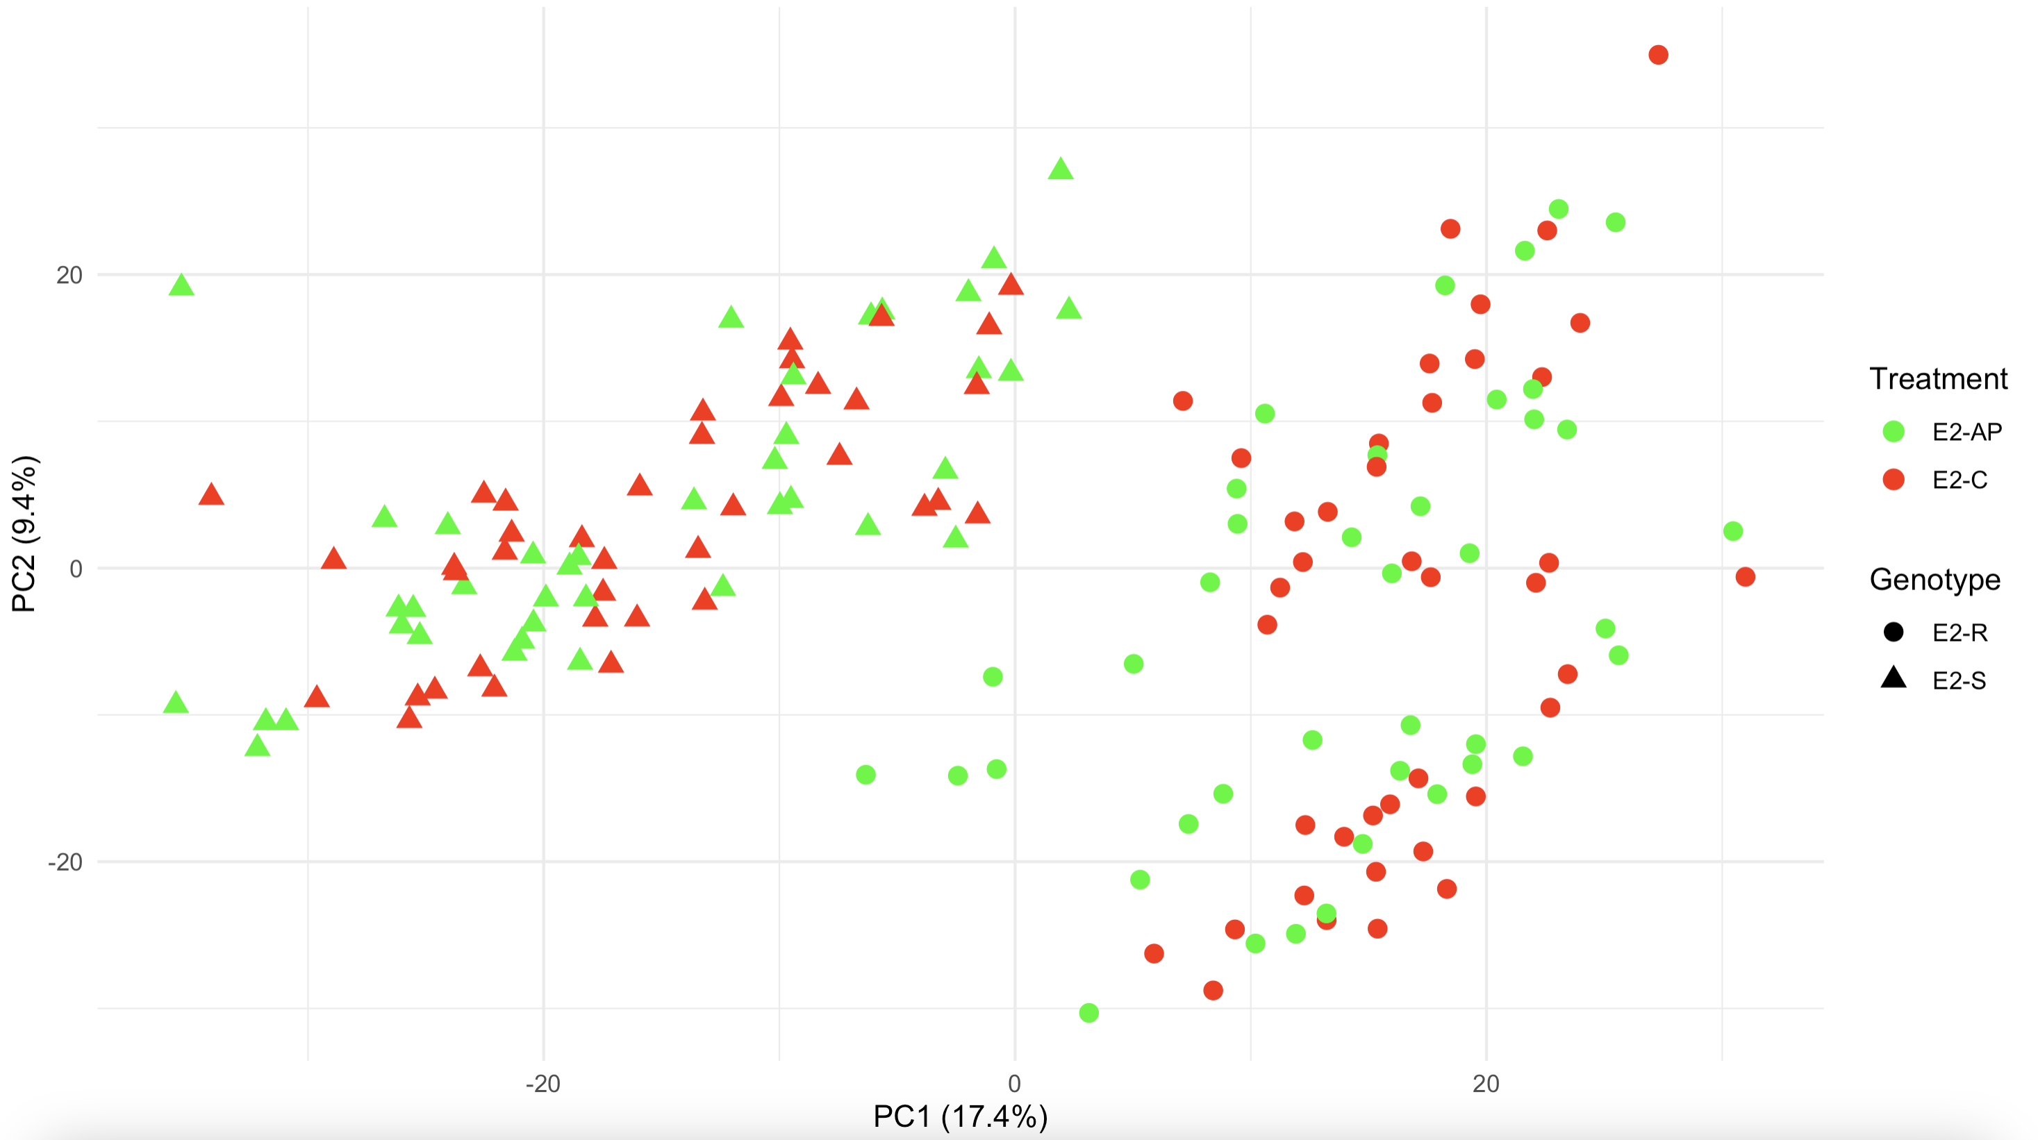
Two first axes of the PCA for the A.pisum experiment with a separation based on genotype and treament

Slide 23
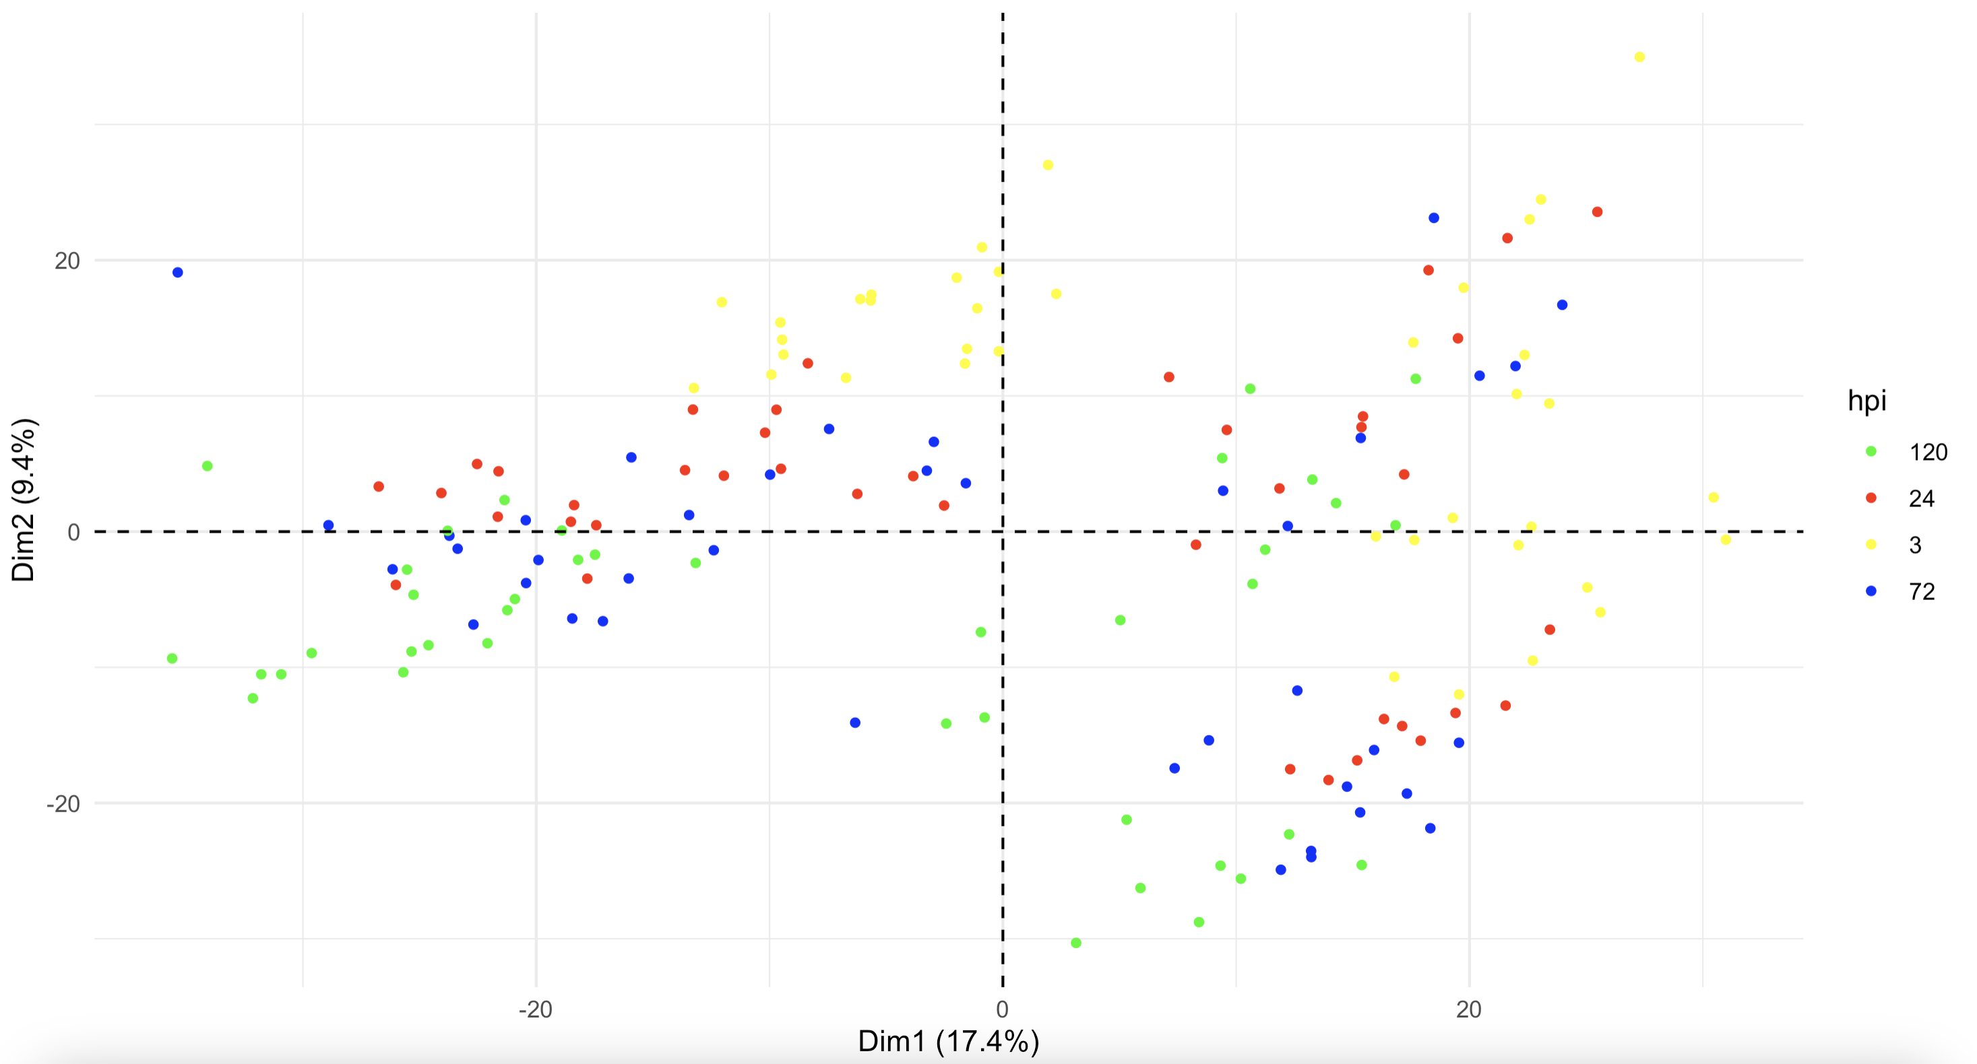
Two first axes of the PCA for the A.pisum experiment with a separation based on time

Slide 24
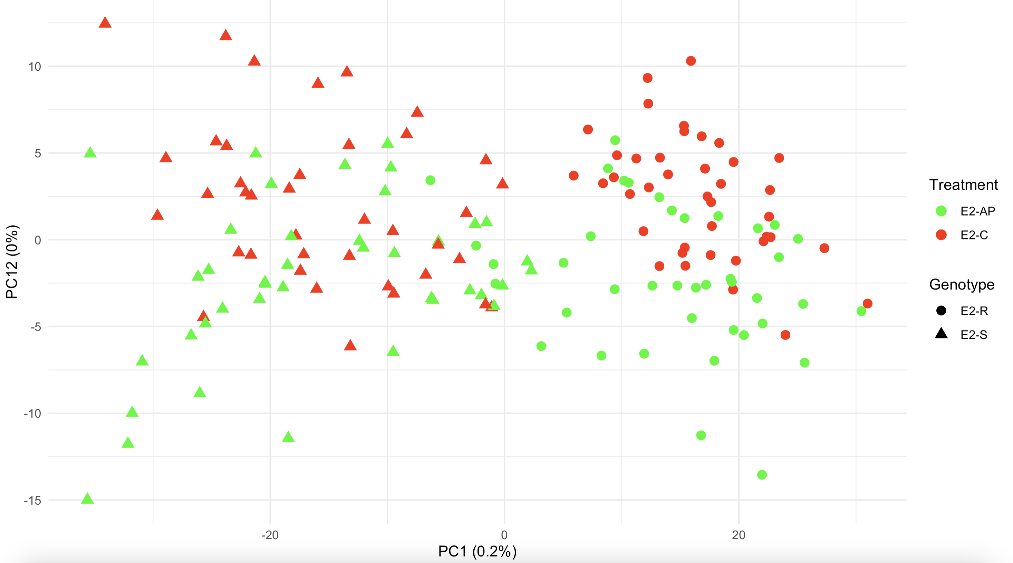
First and twelves axes of the PCA for the A.pisum experiment with a separation based on genotype and treament

Slide 25
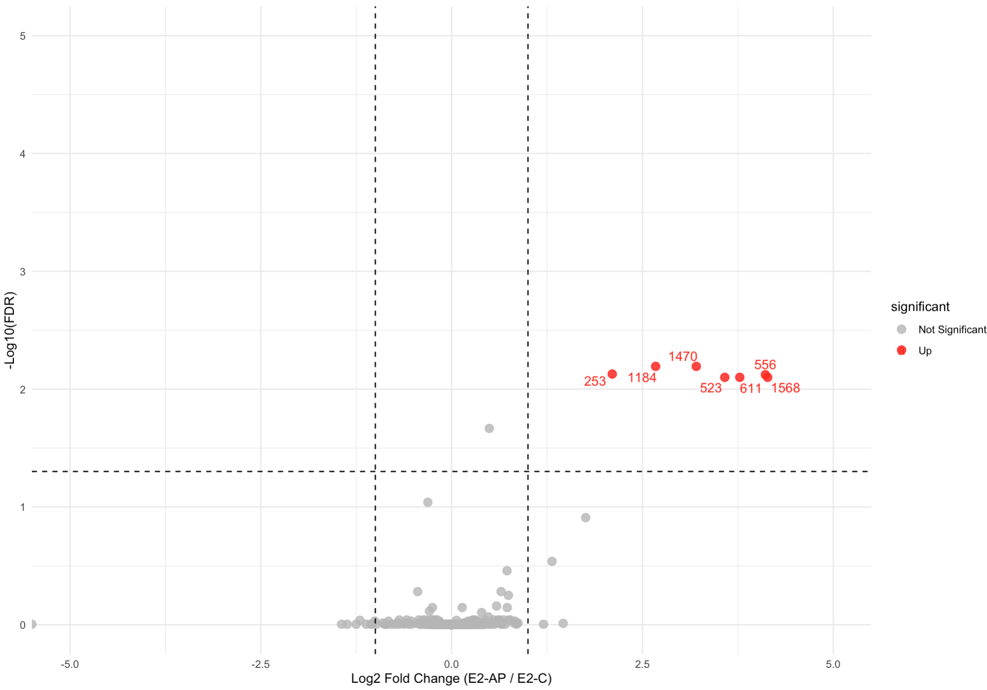
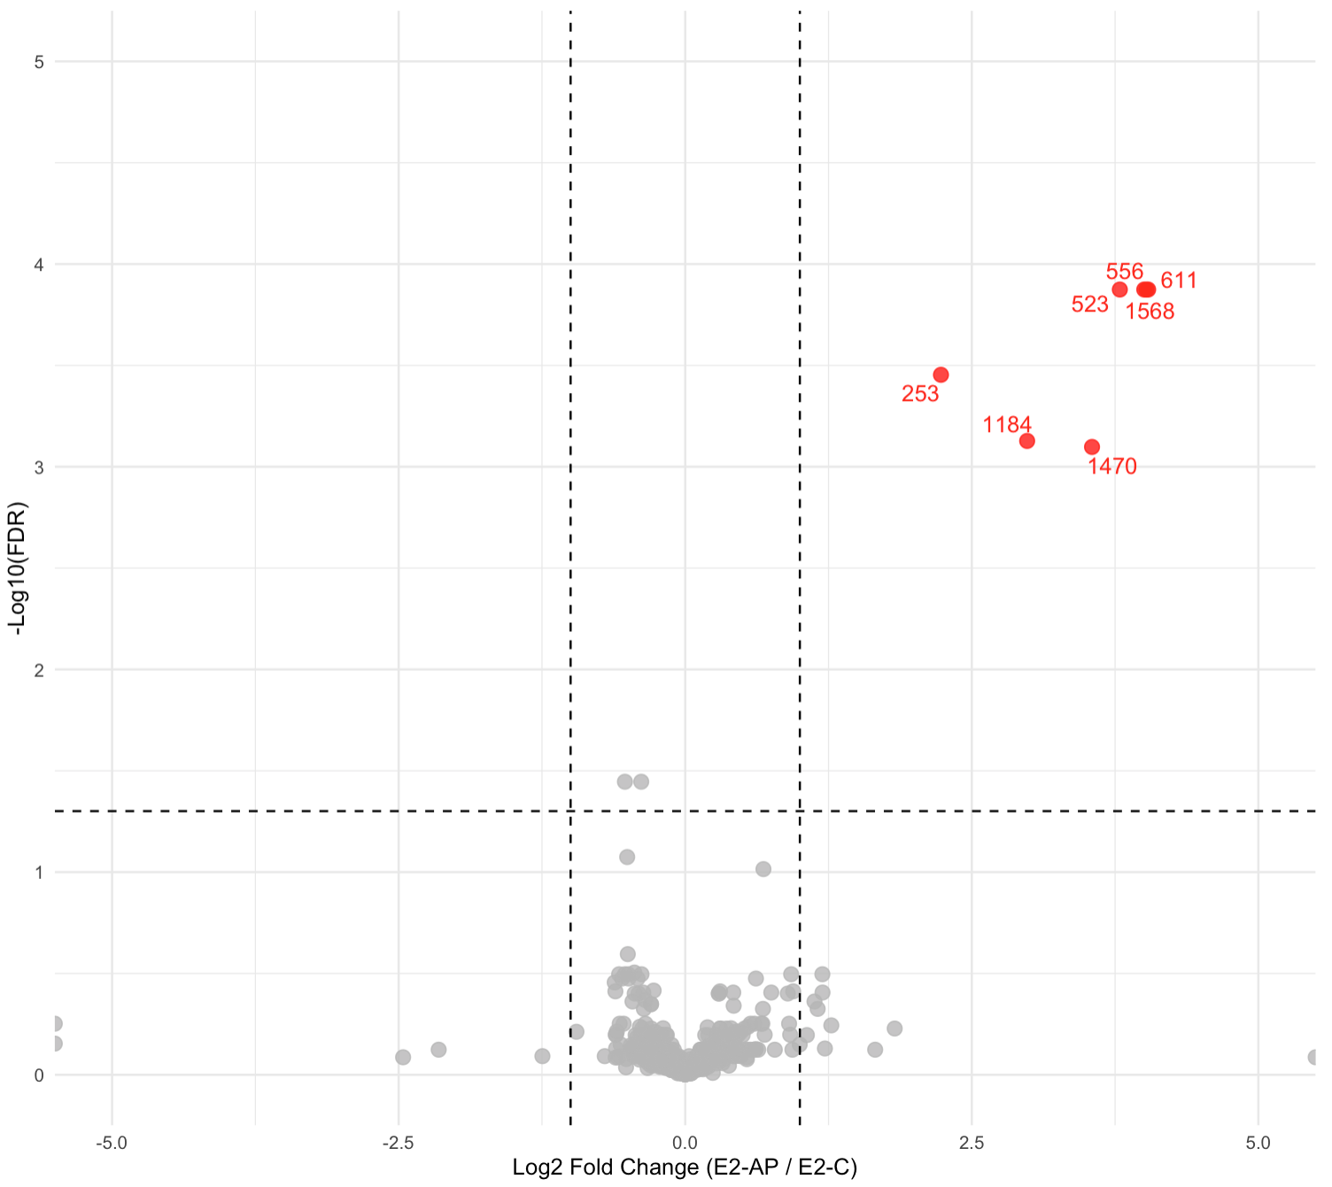
Comparison of metabolites regulation between resistant and susceptible in contact with A.pisum in negative mode
susceptible
resistant

Slide 26
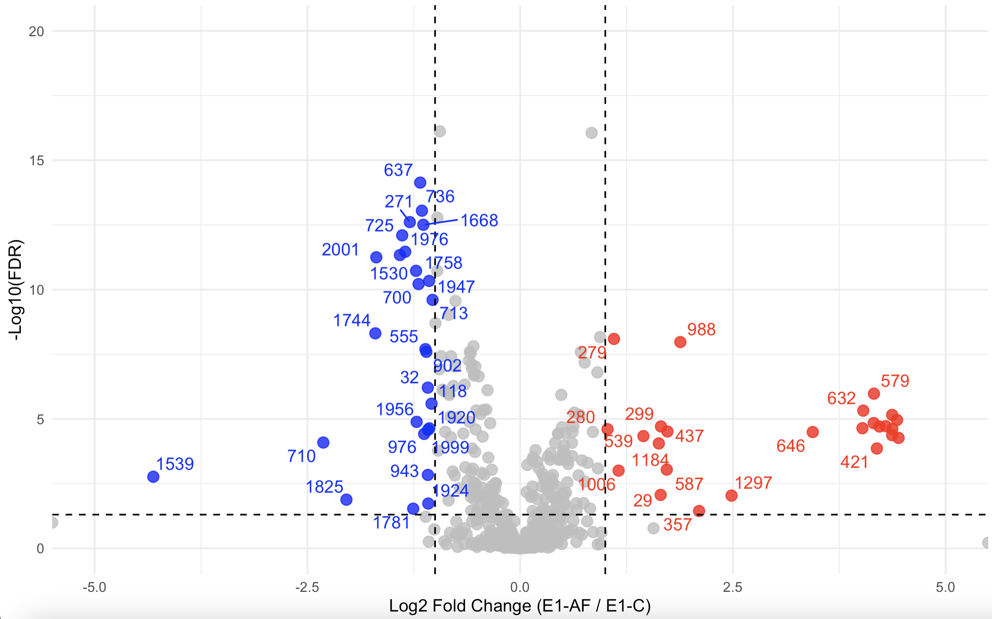
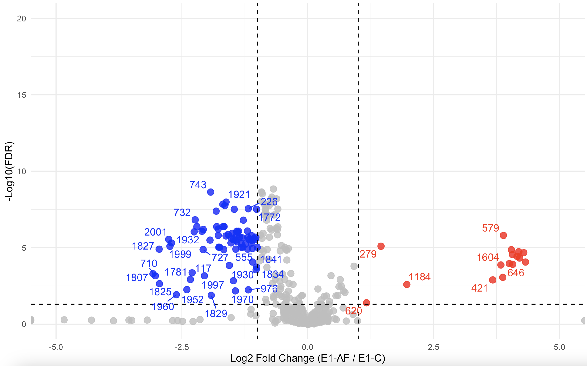
Comparison of metabolites regulation between resistant and susceptible in contact with A.fabae in negative mode
susceptible
resistant

Slide 27
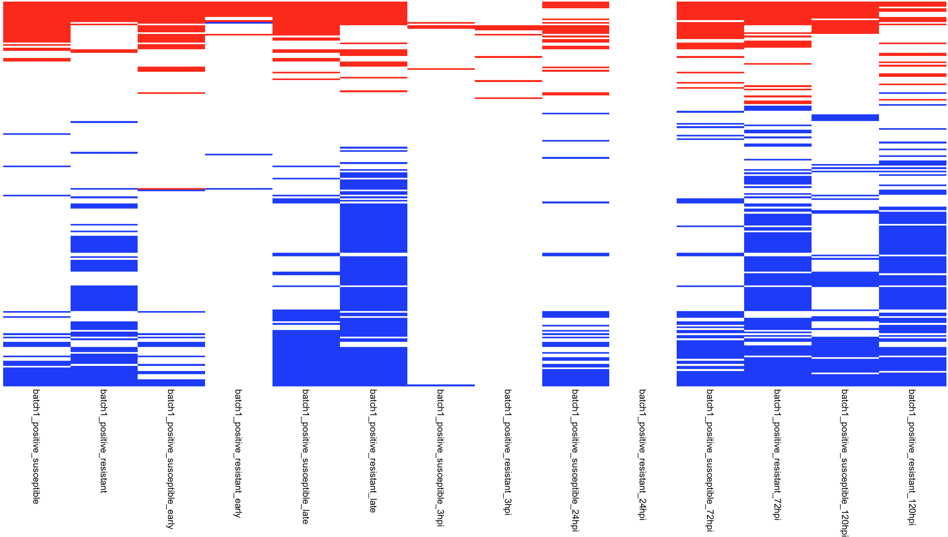
Up and down regulated metabolites detected based on the level of subdivision (negative mode / A. fabae)
Boxplot instead
up
down
Metabolites
S
R
S
R
S
R
S
R
S
R
S
R
S
R
Early
Late
3
24
72
120
Condition

Slide 28
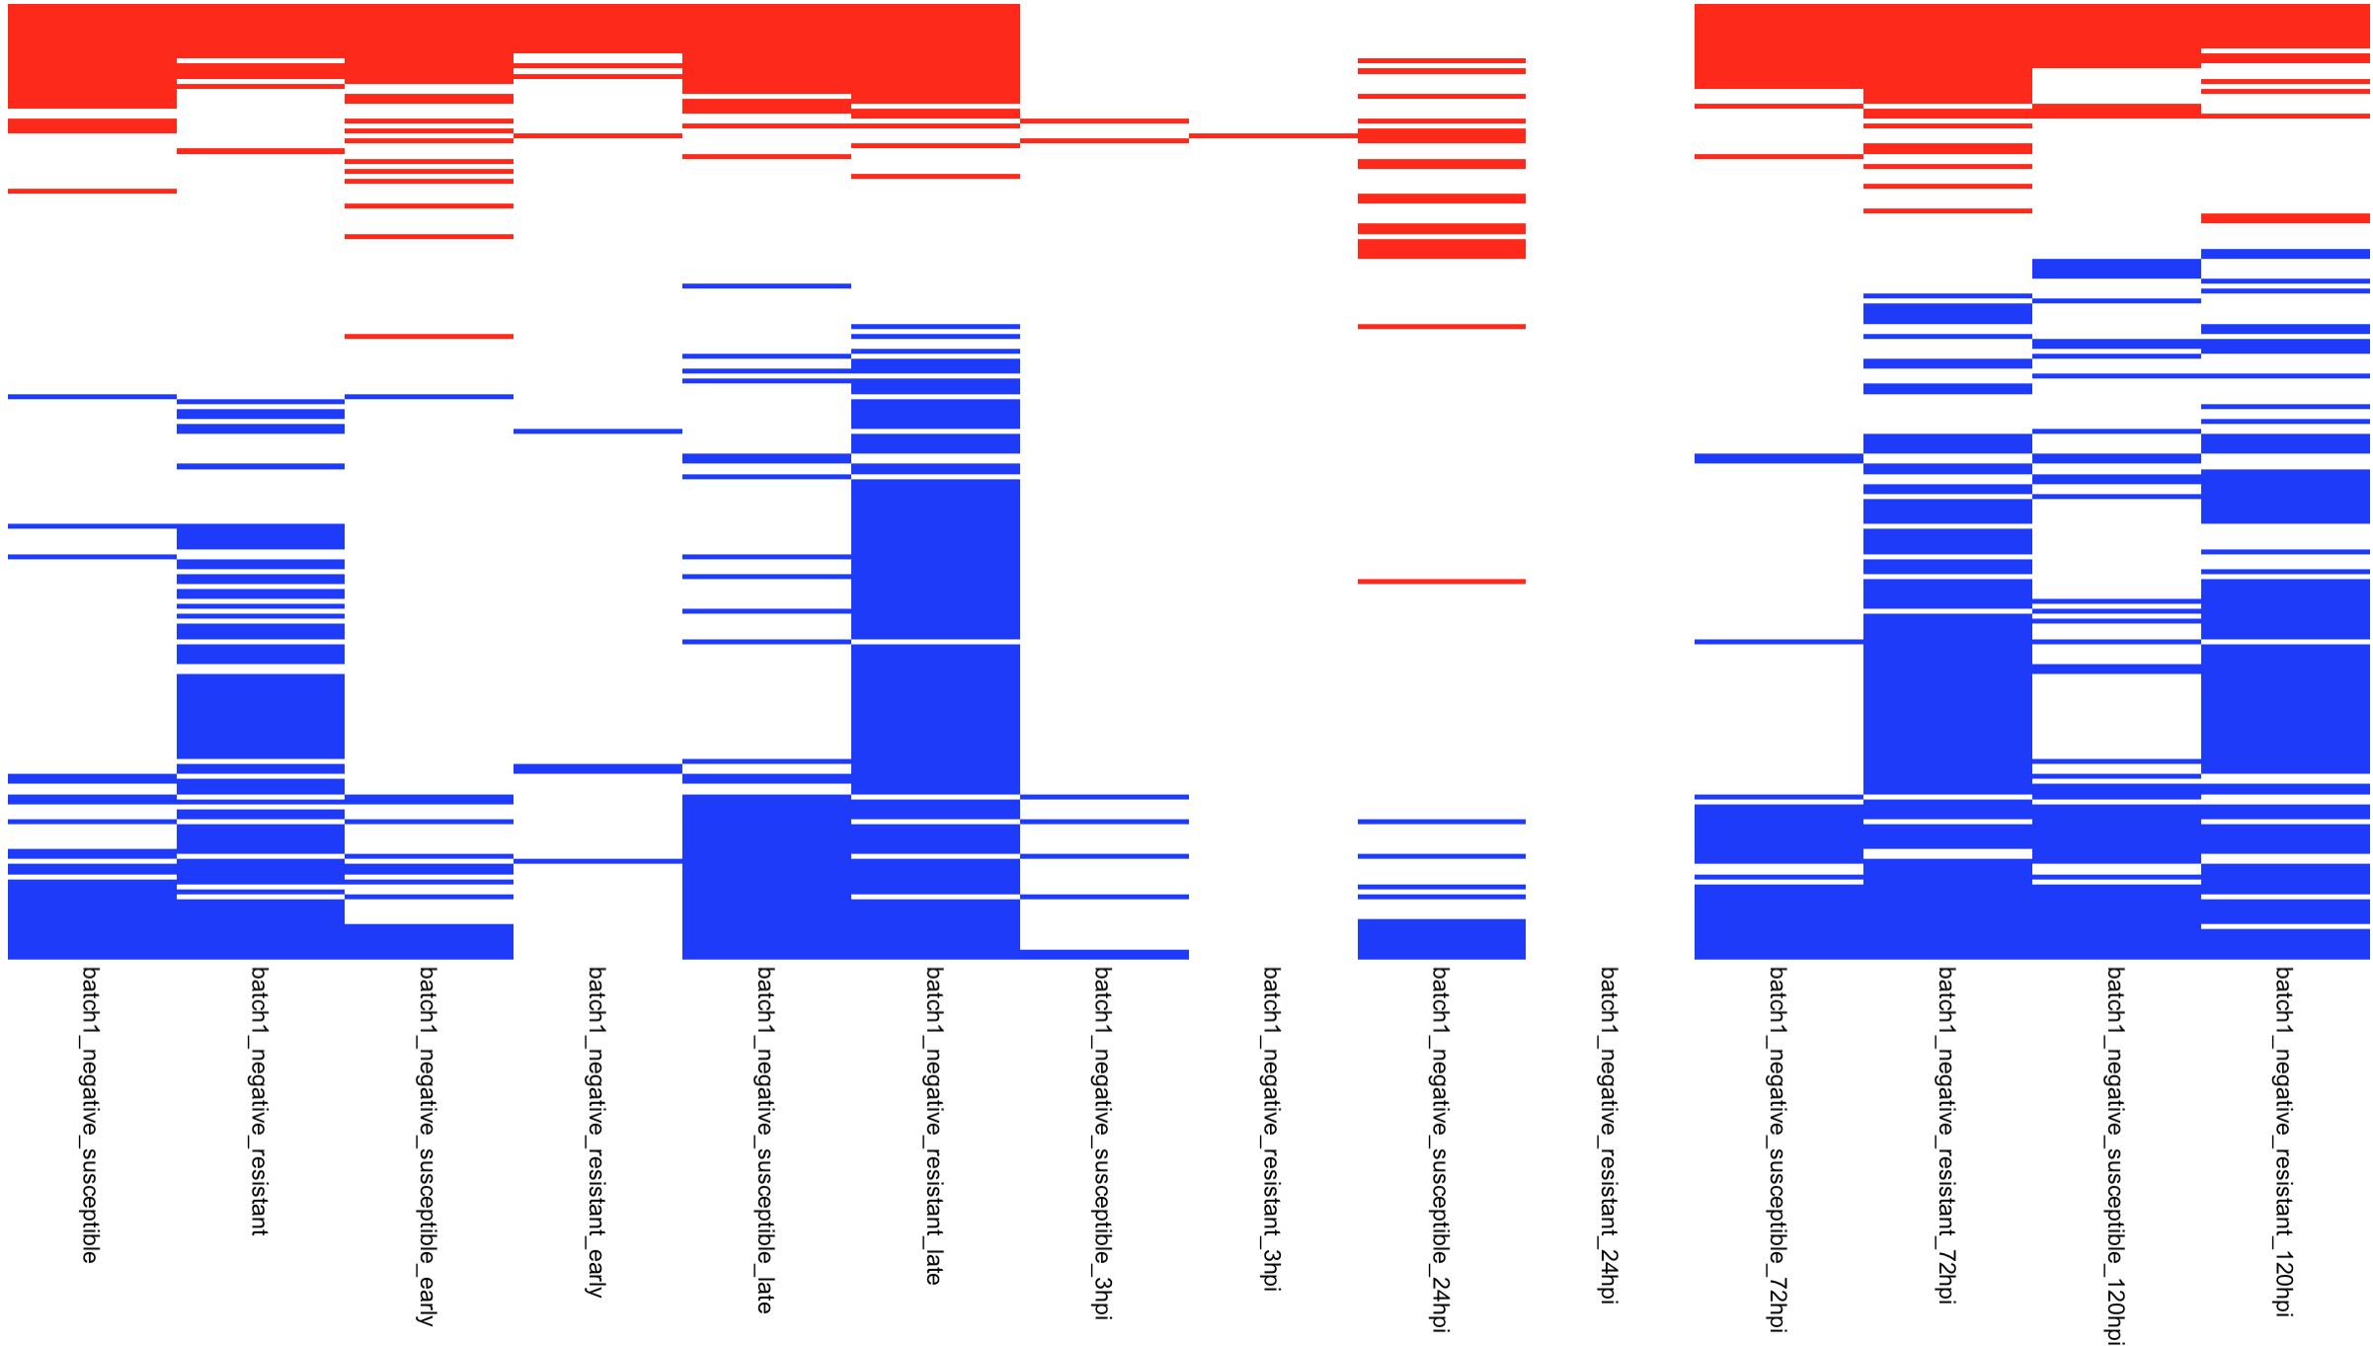
Up and down regulated metabolites detected based on the level of subdivision (positive mode / A. fabae)
up
down
Metabolites
S
R
S
R
S
R
S
R
S
R
S
R
S
R
Early
Late
3
24
72
120
Condition

Slide 29
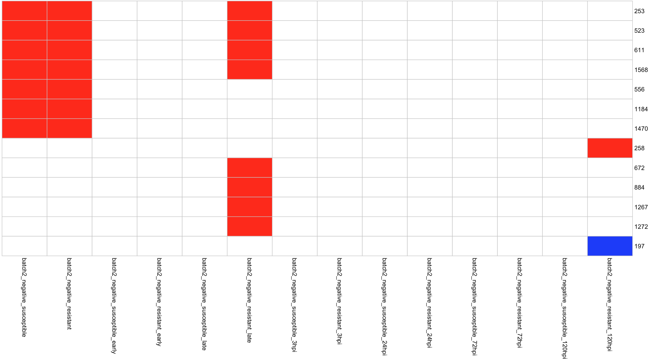
Up and down regulated metabolites detected based on the level of subdivision (negative mode / A. pisum)
up
down
Metabolites
S
R
S
R
S
R
S
R
S
R
S
R
S
R
Early
Late
3
24
72
120
Condition

Slide 30
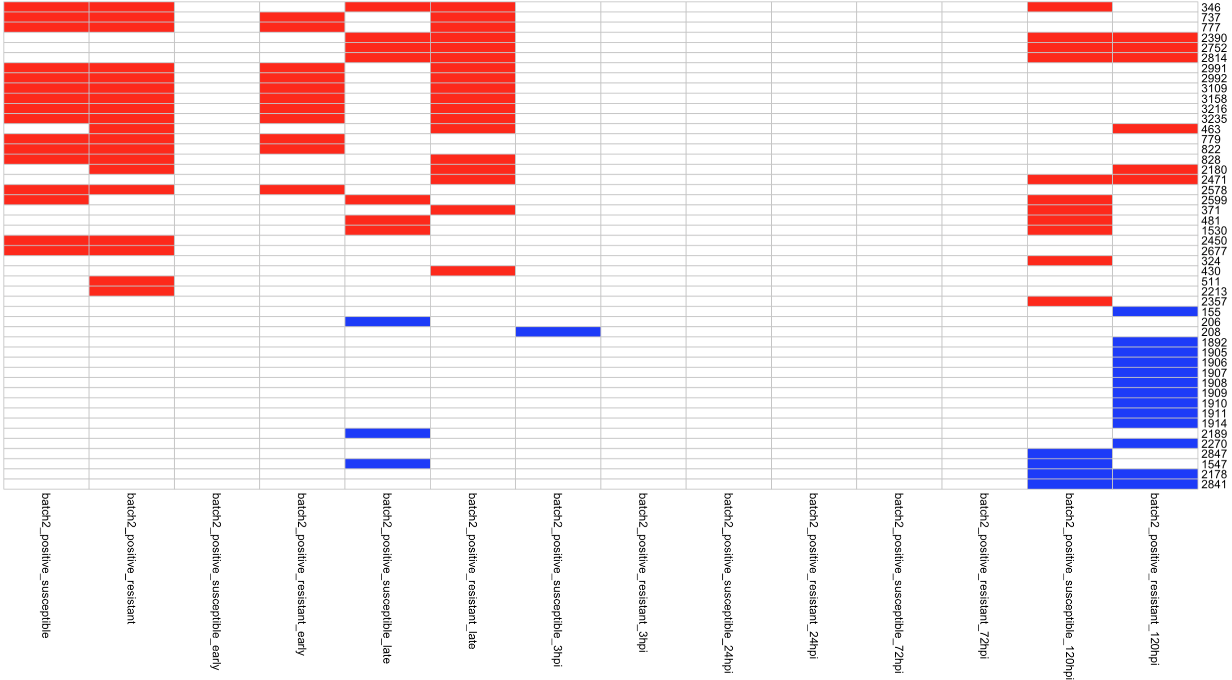
Up and down regulated metabolites detected based on the level of subdivision (negative mode / A. pisum)
up
down
Join negative and positive
Metabolites
S
R
S
R
S
R
S
R
S
R
S
R
S
R
Early
Late
3
24
72
120
Condition

Slide 31
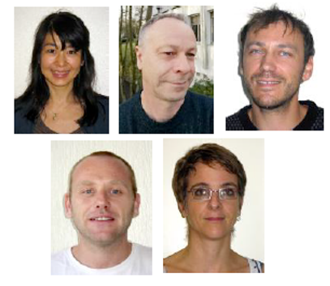

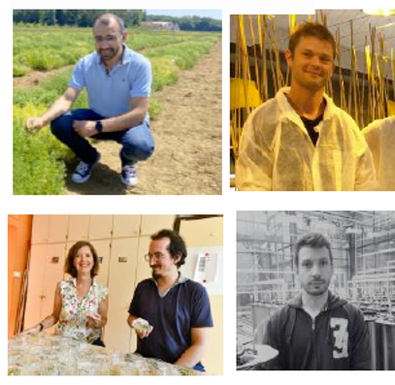


Financeurs: Region Bretagne, departement SPE, ANR, PPR CPA SPECIFICS
Context – State of the art – Strategy – First results – Future perspective – Acknowledgment
06/2025
UMR IGEPP – Team “Ecologie et Génétique des insects”
Akiko Sugio
Gaëtan Denis
Jean-Christophe Simon
Julie Jaquiéry
Marc Galland
Maïwenn Lefloch
Romuald Cloteau
Stéphanie Morlière
Max plank institute
Grit kunnert
Surhud sant
UMR Agroécologie Dijon
Anthony Klein
Baptiste Imbert
Jonathan Kreplak
Judith Burstin
Mathieu Chanis
Nadim Tayeh
UMR IGEPP – Team “Resistance et durabilité”
Angélique Lesné
Isabelle Glory
Jean-Philippe Rivière
Marie Laure Pilet Nayel
06/2025

